Slide 1
Consumer Complaints Data Analysis using Apache Spark
Team Members:
Pooja Khobare
Chaitali Khedkar
Rajshree Labade
Ashwin Khaire
Dipali Kshirsagar
UNDER THE GUIDANCE OF – PROF. HUMA MAM & PROF. MAYUR SIR
Tools & Technologies: PySpark, Databricks, Python, CSV, Parquet

Slide 2
Introduction
This project performs an End-to-End ETL (Extract, Transform, Load) process on the Consumer Complaint Dataset.
Goal: Clean, transform, and analyze customer complaints to find insights.
Implemented using PySpark on PyCharm.
Final results visualized using dashboards and tables.

Slide 3
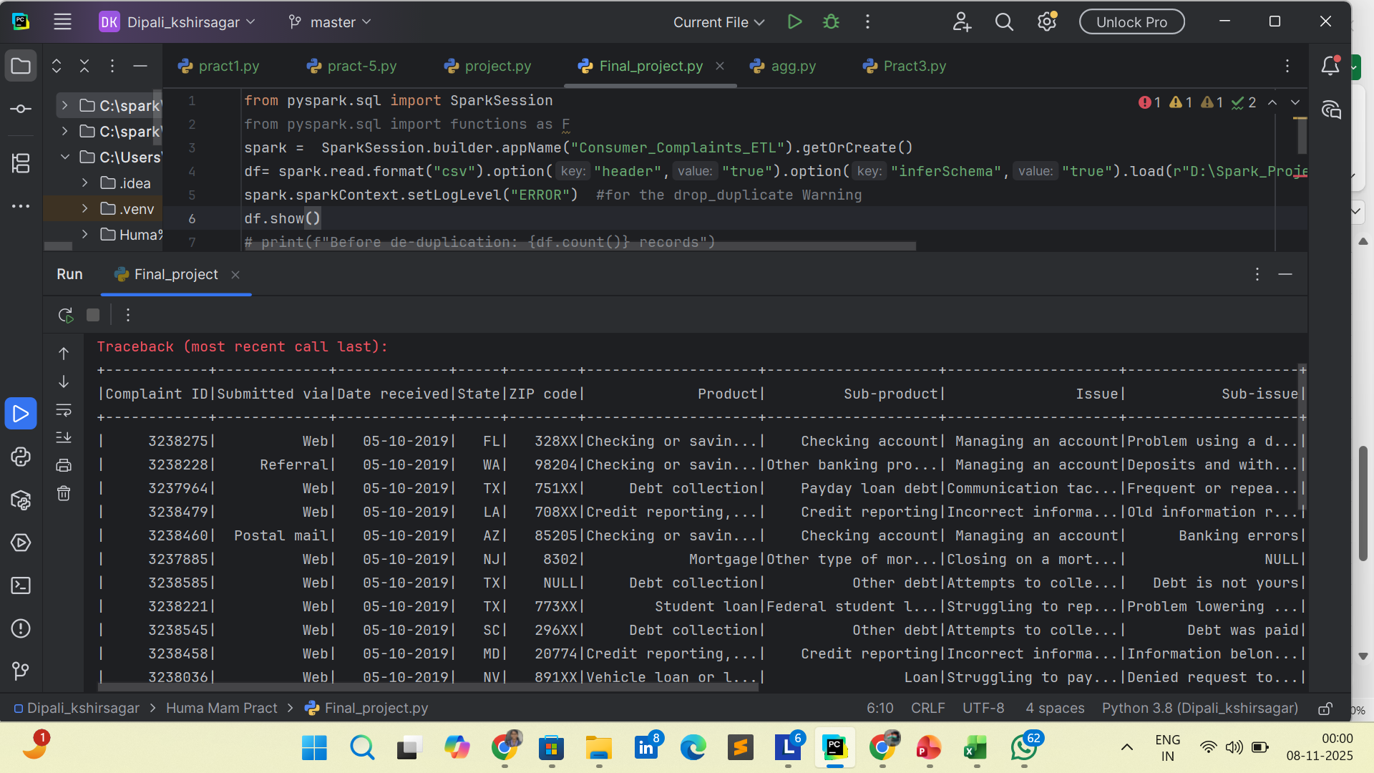
Source / Raw Data Details Understanding Our Data Source
Content:
Dataset: Consumer Complaint Database
Format: CSV file with headers
Initial Record Count: 3585 records (sample shown)
Key Attributes:
Identifiers: Complaint ID, Date received
Location: State, ZIP code
Product Details: Product, Sub-product
Issue Details: Issue, Sub-issue
Company Info: Company name, Response details
Process Tracking: Date sent to company, Company response, Timely response flag
Data Quality Observations:
Multiple NULL values present in several columns
Some records missing State and ZIP code information

Slide 4
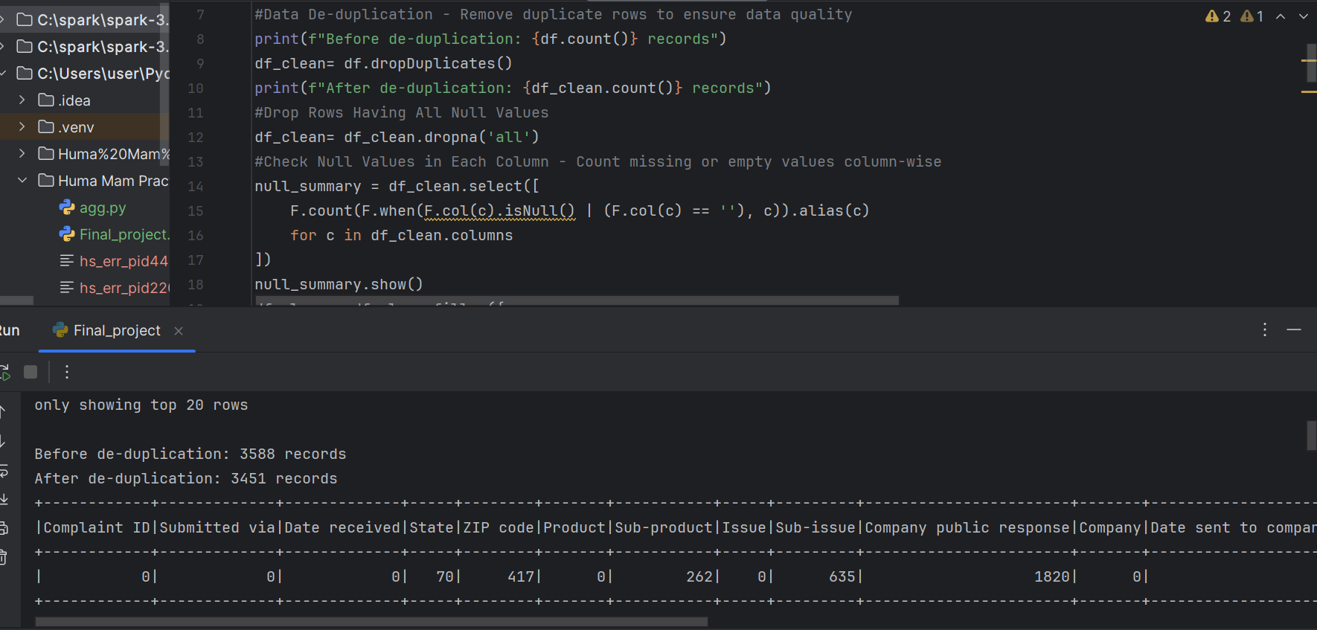
Data Cleaning Process
Dropped duplicates using dropDuplicates()
Handled missing values with fillna()
Replaced nulls with descriptive values
1.df.drop_duplicates() 2. df.distinct()

Slide 5
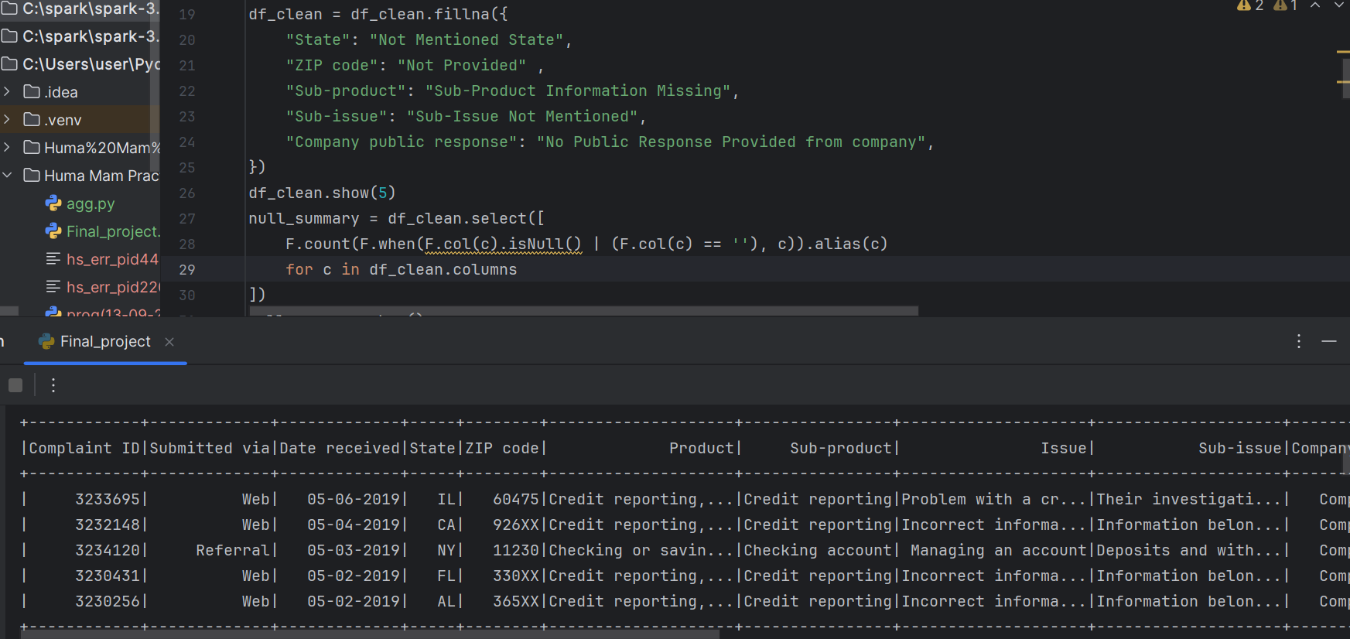
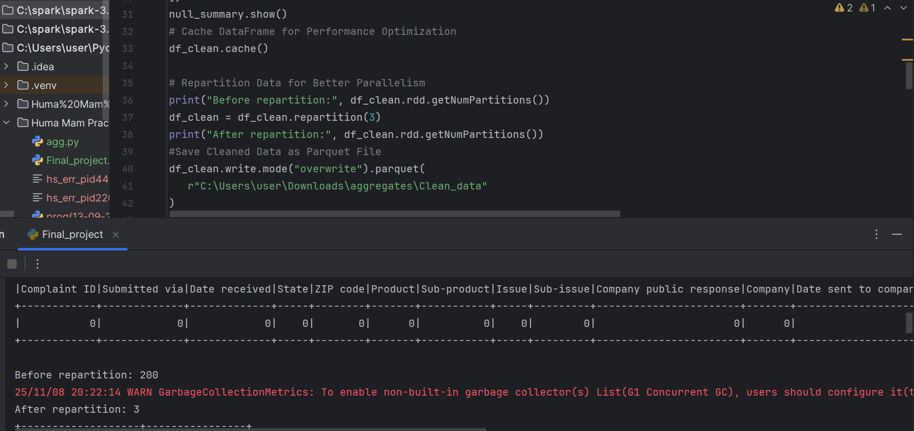
OPTIMIZATION

Slide 6
Transformations Done
Created Temp SQL View: consumer_complaints
Applied Spark SQL queries for aggregations

Slide 7
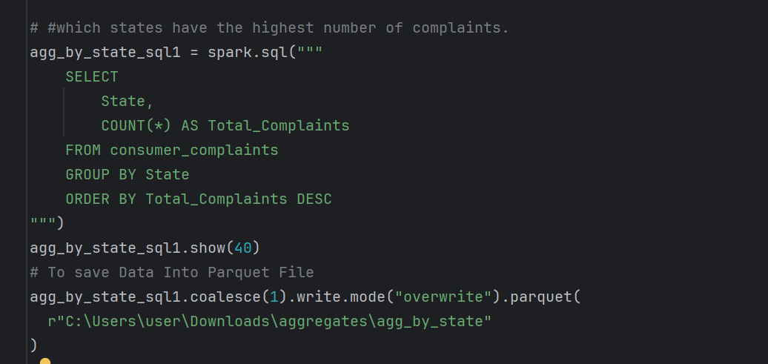
Aggregate Function
1. States - wise Total_Complaints

Slide 8
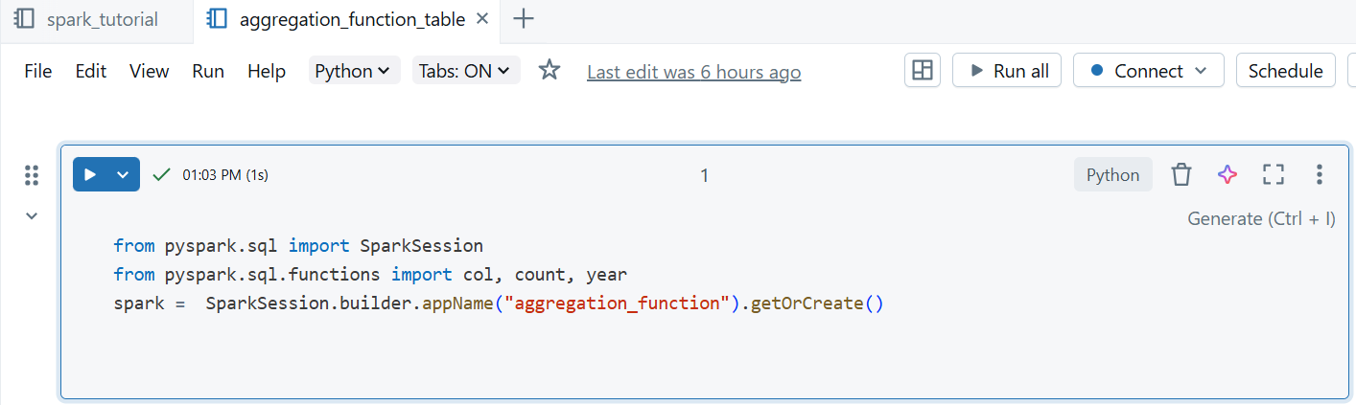
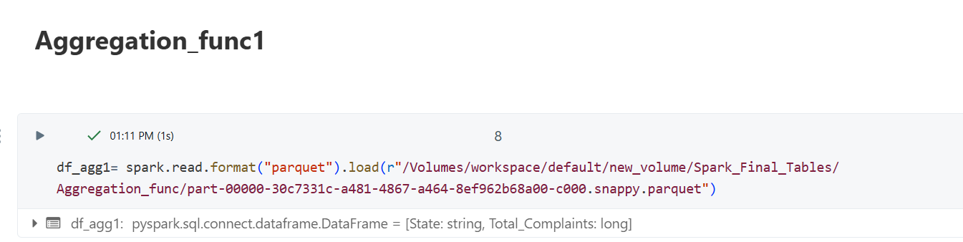
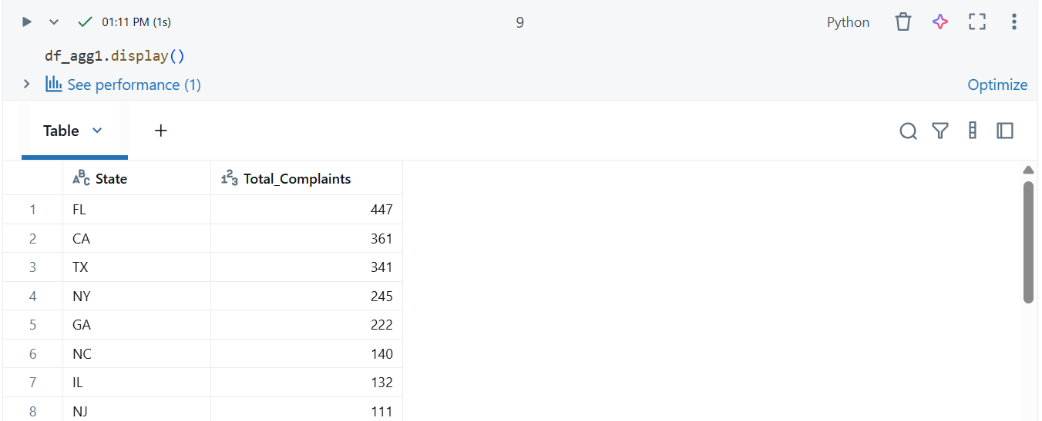
Databricks Table

Slide 9
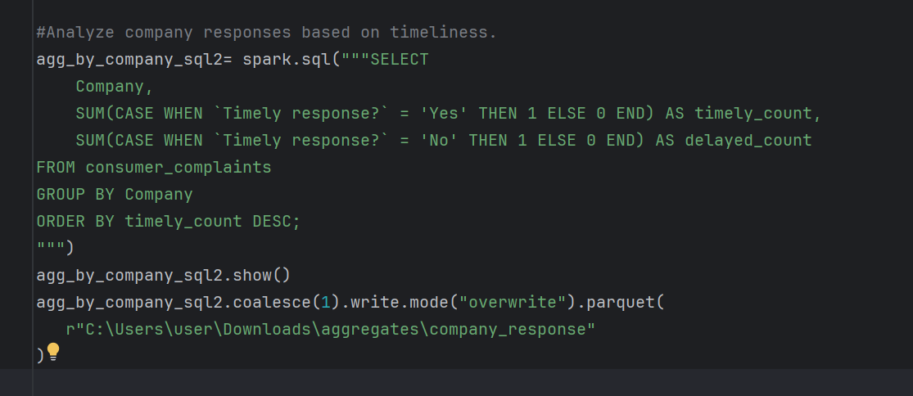
Aggregate Function
2. Sum of Timely Response by Company

Slide 10
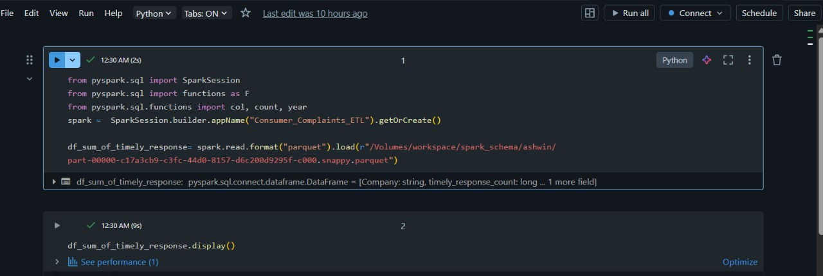
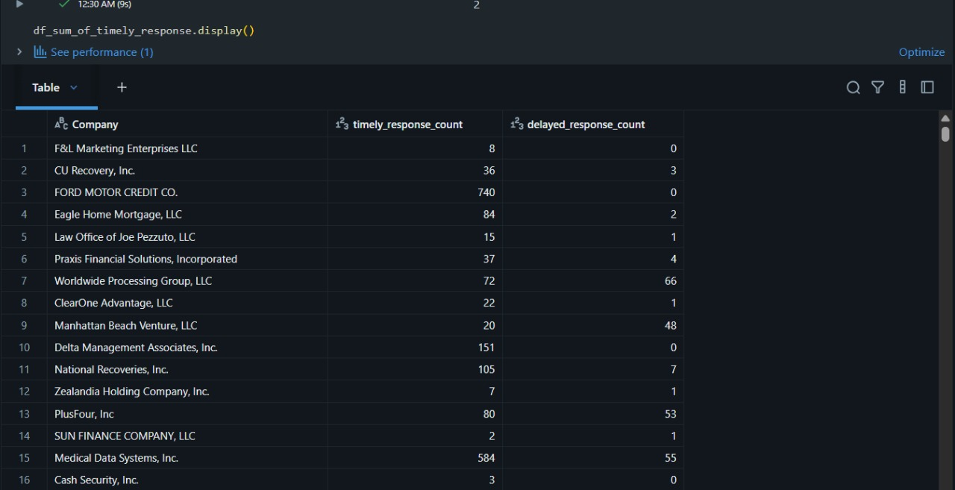
Databricks Table

Slide 11
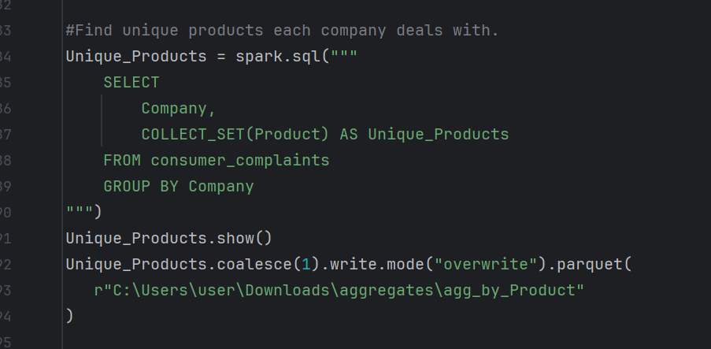
Aggregate Function
3.Companies and Their Product List

Slide 12
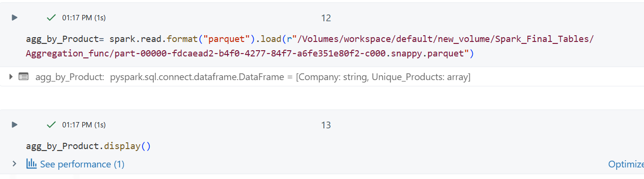
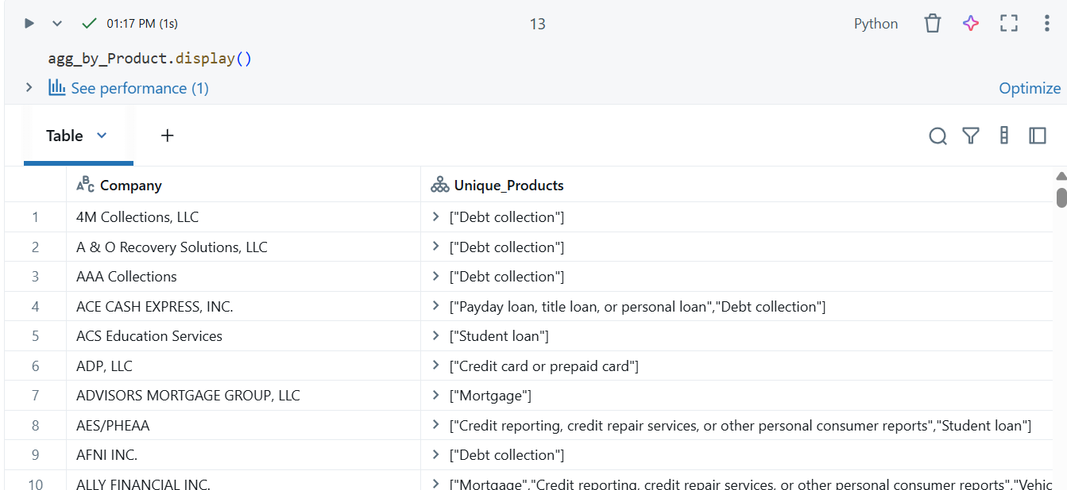
Databricks Table

Slide 13
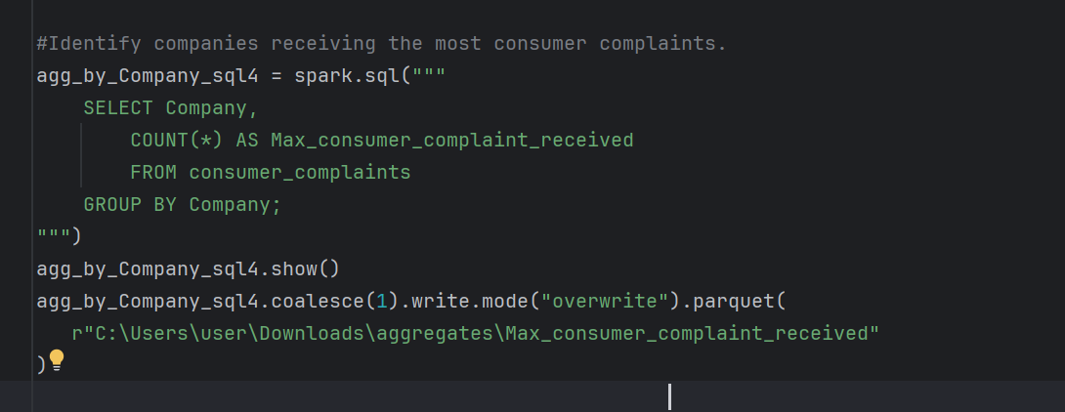
Aggregate Function
4. Company-wise Total Consumer Complaint Received

Slide 14
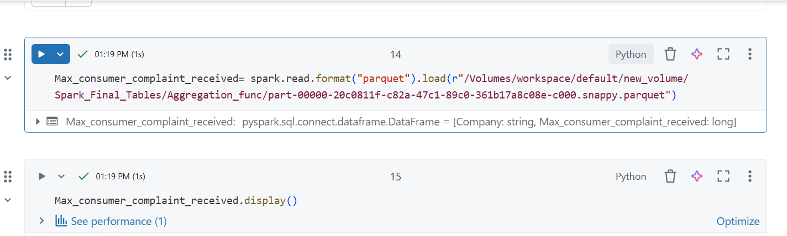
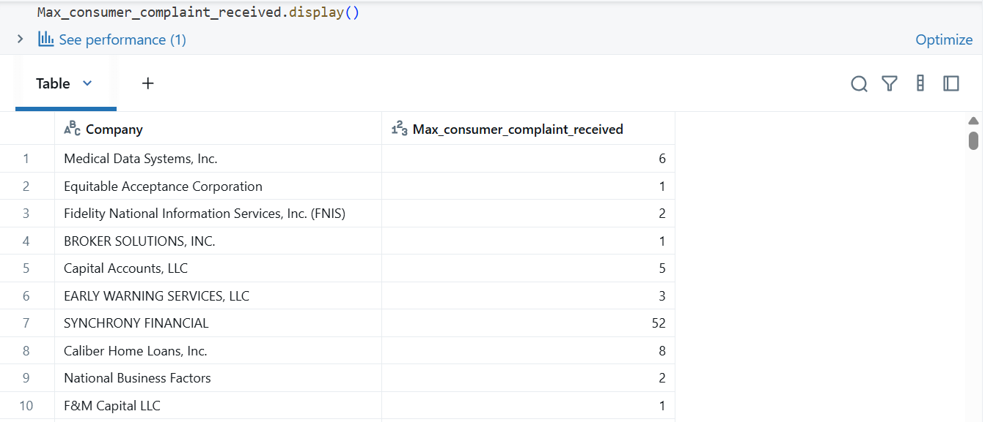
Databricks Table

Slide 15
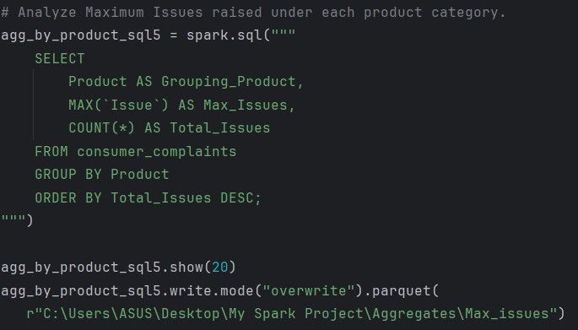
Aggregate Function
5. Product-wise Issues Count

Slide 16
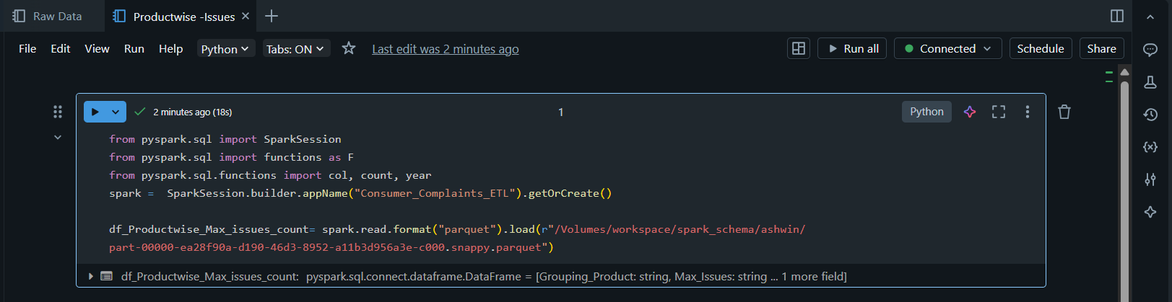
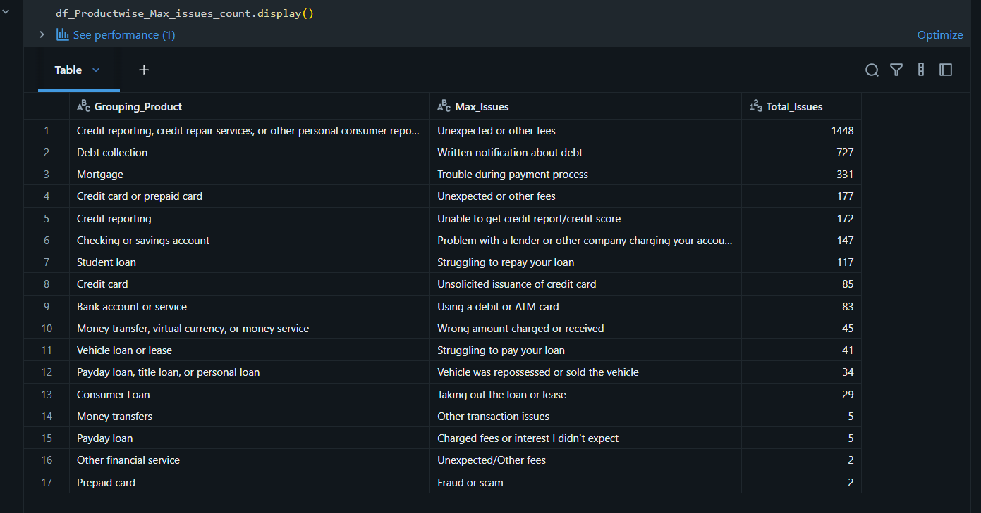
Databricks Table

Slide 17
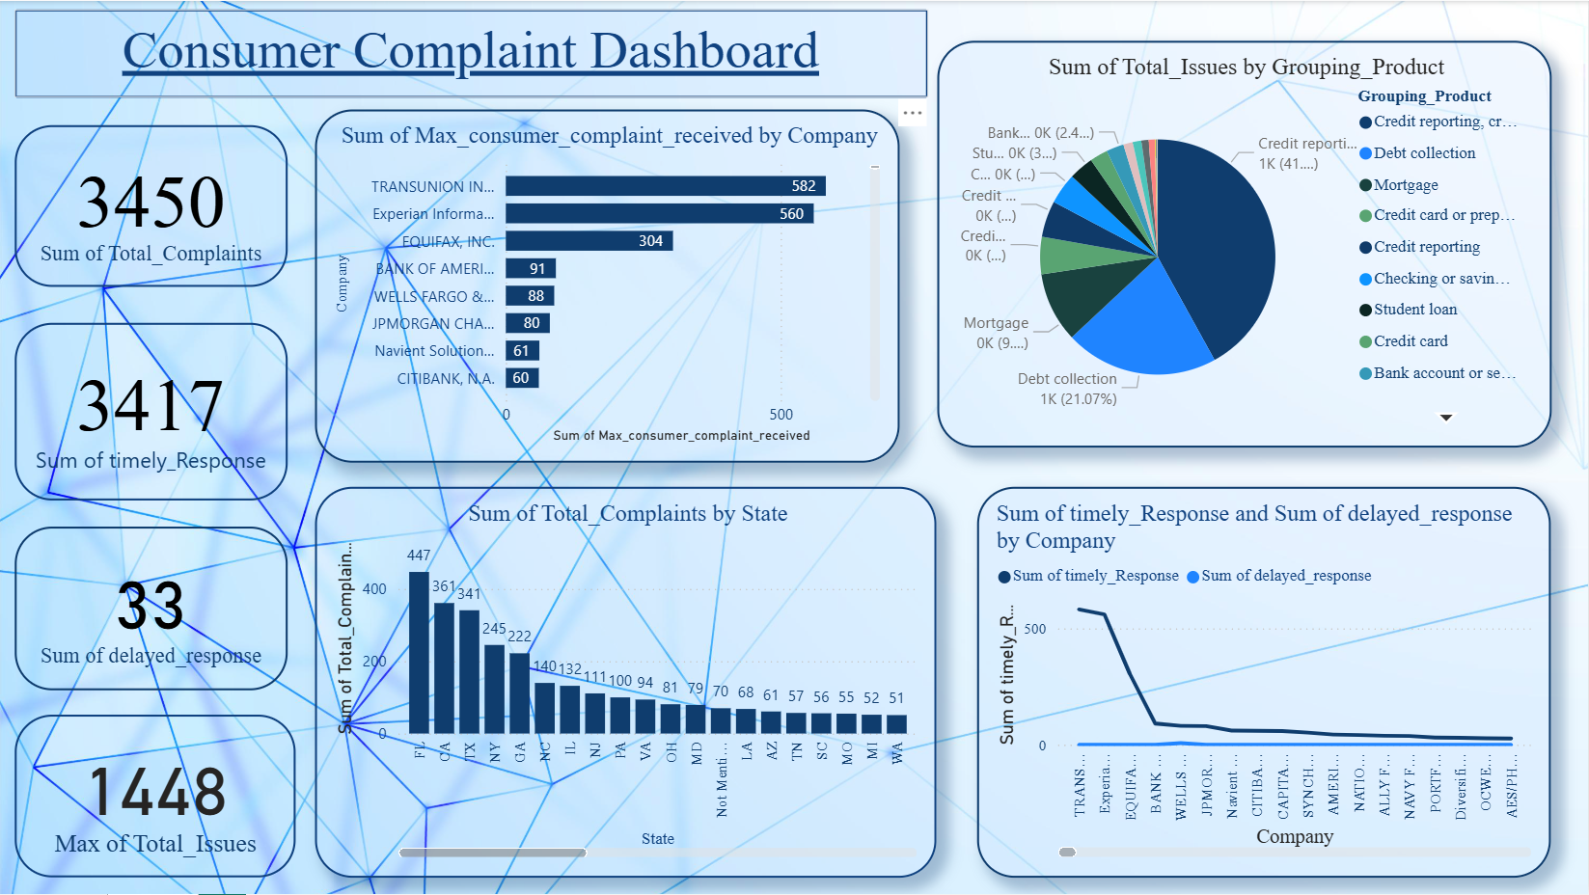
Dashboard Prepared

Slide 18
Conclusion & Learnings
Understood ETL lifecycle using PySpark
Improved data quality
Gained business insights via SQL
Created dashboards for visual analysis
Understood real-world data engineering workflow

Slide 19
EFFORTS SHEET
DATA SCOUT- Finds useful dataset and combined & aggregations.
DATA CLEANER- Cleaned the raw data and made ready to use & aggregations.
TABLE BUILDER -Managed databricks for smooth data handling & aggregations.
DASHBOARD DESIGNER- Created an insightful dashboard & aggregations.
PRESENTING LEAD – From explaning a data to finding an impact & aggregations.

Slide 20

Thank You

